Slide 1
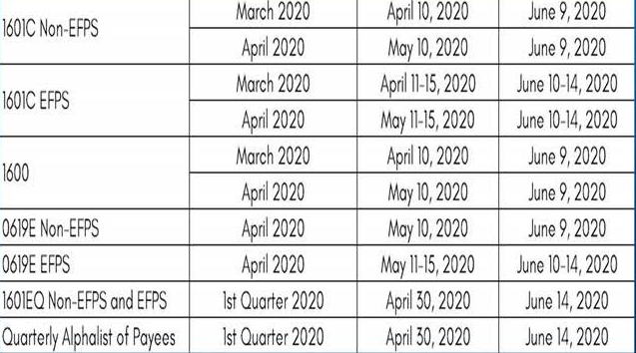
WITHHOLDING TAX
BIR FORM | PERIOD | ORIGINAL DEADLINE | NEW DEADLINE

Slide 2
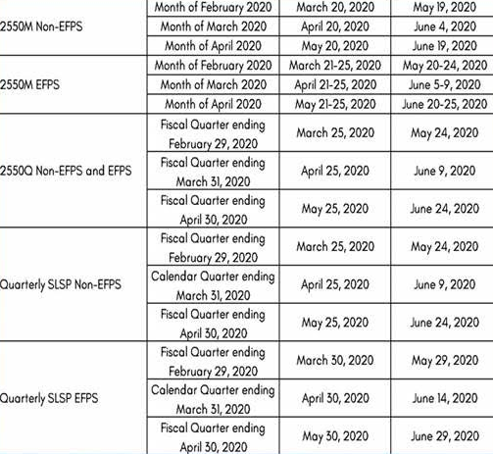
BIR FORM | PERIOD | ORIGINAL DEADLINE | NEW DEADLINE
VAT

Slide 3
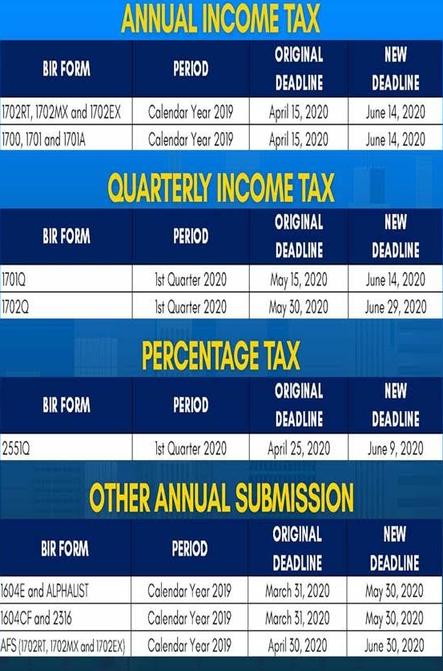
ANNUAL INCOME TAX
BIR FORM | PERIOD | ORIGINAL DEADLINE | NEW DEADLINE
QUARTERLY INCOME TAX
BIR FORM | PERIOD | ORIGINAL DEADLINE | NEW DEADLINE

Slide 4
PERCENTAGE TAX
BIR FORM | PERIOD | ORIGINAL DEADLINE | NEW DEADLINE
OTHER ANNUAL SUBMISSION
BIR FORM | PERIOD | ORIGINAL DEADLINE | NEW DEADLINE

